Slide 1
2023 REORGANIZATION
ROCHESTER POLICE DEPARTMENT
October 10, 2023

Slide 2
Elevated levels of violent crime; specifically, fatal and non-fatal shootings
Reduced availability of resources stemming from higher rates of separation and fewer candidates taking exams
CURRENT CHALLENGES
An imbalanced workload in the Patrol Division across Sections and Platoons
Growing burden on active personnel (mandated overtime, elevated stress, job satisfaction, etc.) due to staffing shortages and recruitment issues
Increasing overtime expenditures particularly connected to personnel shortages and case investigations

Slide 3
REORGANIZATION OVERVIEW
The goal is to strategically align resources with the Department’s three core priorities:
    Violence prevention
    Priority calls for service response
    Community engagement
This model focuses on having a direct impact on violent crime by dedicating resources to violence prevention, aligning investigative functions, and balancing the priority calls for service workload
The reorganization allows the Department to pivot to address the concerns of violence while creating a framework for future growth and sustainability

Slide 4
ORGANIZATIONAL
CHART: TOP LEVEL
Office of the Chief
Business Intelligence
Office
Operations
Bureau
Investigations
Division
Administration
Bureau
Professional Standards
Section
Patrol
Division
Staff Duty
Office
Patrol
Sections
Major Crimes
Section
Special Investigations
Section
Homicide
Unit
Surveillance & Elec. Support
Unit
Narcotics
Unit
Specialized Teams
Special Operations
Bureau
Community Affairs
Division
Violence Prevention
Section
Neighborhood Services
Section
Strategic Initiatives
Unit
Community Relations
Unit
Lake
Genesee
Goodman
Clinton
Bomb
Hostage Negotiations
Mobile Field Force
SCUBA
Long-Term Disability
Unit
Special Operations
Team
Special Events
Unit
Criminal Investigations
Section
Special Victims
Unit
Technicians
Unit
PAB Liaison
Personnel
Office
Budget
Office
Research & Evaluation
Section
Administrative Services
Division
Professional Development
Section
Technical Services
Section
Tactical
Section
Licensing
Unit
Tactical
Unit
Recruitment
Unit
Mounted
Unit
K-9
Unit
Traffic Enforcement
Unit
SWAT
Downtown
Unit
(Detail)
Existing
Moving
New

Slide 5
NEW OPERATIONS BUREAU
4-Section Patrol model redistributes Central and 4th Platoon personnel into the three primary platoons
Lake & Clinton Sections remain at 10 car beats
Goodman Section goes from 7 car beats to 9
  Gains current beat 229 which becomes beat 275
  Gains current beat 263 which becomes beat 285
Genesee Section goes from 7 car beats to 8
  Beat 263 moves to Goodman Section
  Gains current beat 209 which becomes beat 263
  Gains current beat 219 which becomes beat 273
Operations
Bureau
Patrol
Division
Staff Duty
Office
Patrol
Sections
Specialized Teams
Lake
Genesee
Goodman
Clinton
Bomb
Hostage Negotiations
Mobile Field Force
SCUBA
Special Events
Unit
SWAT

Slide 6

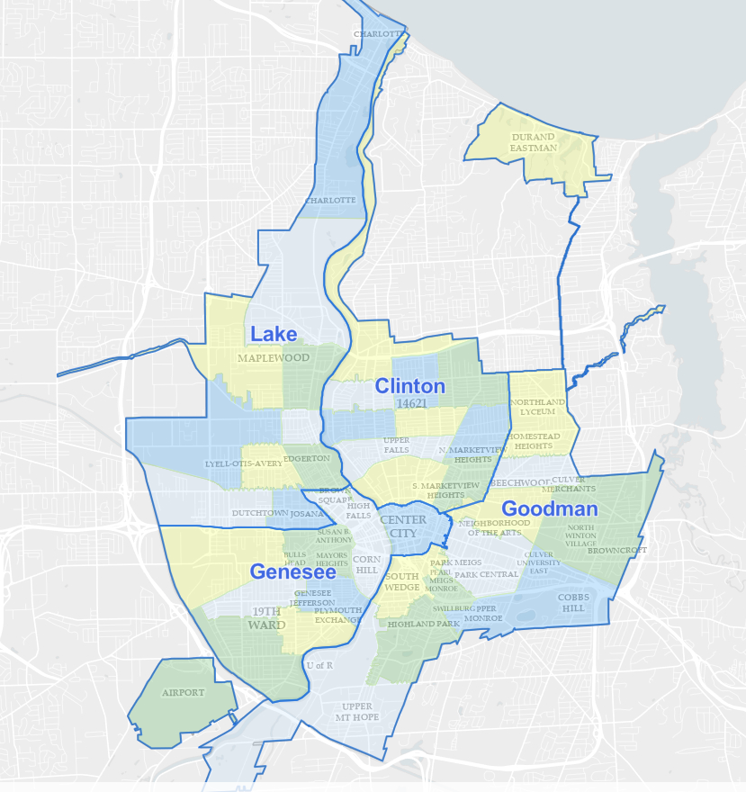
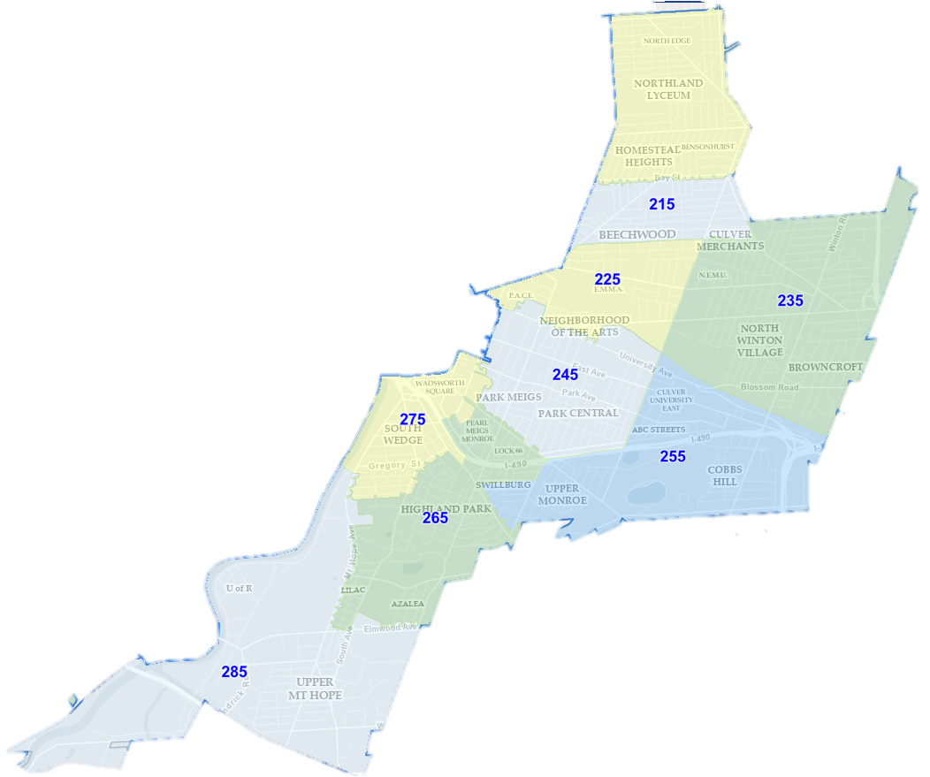
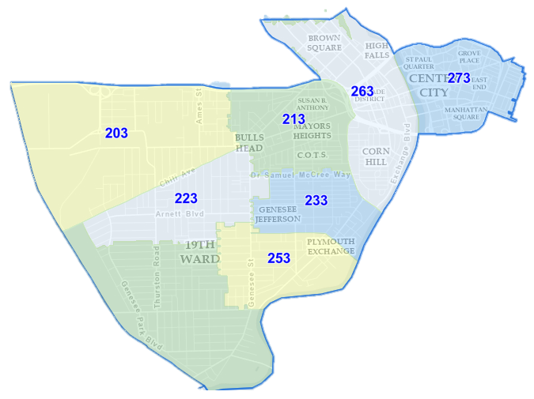
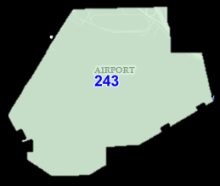
4-QUADRANT PATROL DESIGN
New Genesee Section
New Goodman Section

Slide 7
PATROL STAFFING MODEL
Patrol Officer Level | Recommended | Current
Authorized | 357 | 366
Assigned (all wheels) | 321 (10% vacancy) | 289 (21% vacancy)
Daily Assigned (2/3 wheels) | 215 | 192
On-Duty Level (based on 64.4% show rate) | 139 | 124
Officers by Section/Platoon | 1st | 2nd | 3rd | Total
Lake | 30 | 30 | 30 | 90 (75)
Genesee | 30 | 27 | 30 | 87 (60)
Goodman | 30 | 24 | 30 | 84 (60)
Clinton | 33 | 30 | 33 | 96 (81)
Total | 126 | 111 | 120 | 357 (276)
Sergeants by Section/Platoon | 1st | 2nd | 3rd | Total
Lake | 3 | 3 | 3 | 9
Genesee | 3 | 3 | 3 | 9
Goodman | 3 | 3 | 3 | 9
Clinton | 4 | 3 | 4 | 11
Total | 13 | 12 | 13 | 38

Slide 8
NEW SPECIAL OPERATIONS BUREAU
Led by a Deputy Chief
  Tactical Section reports directly to the Deputy Chief
Two new Divisions are created: Investigations and Community Affairs
Community Affairs Division
  Violence Prevention Section
  Neighborhood Service Section
Investigations Division
  Major Crimes Section
  Special Investigations Section
  Criminal Investigations Section

Slide 9
ORGANIZATIONAL
CHART: SPECIAL OPERATIONS BUREAU
Investigations
Division
Major Crimes
Section
Special Investigations
Section
Homicide
Unit
Surveillance & Elec. Support
Unit
Narcotics
Unit
Special Operations
Bureau
Community Affairs
Division
Violence Prevention
Section
Neighborhood Services
Section
Strategic Initiatives
Unit
Community Relations
Unit
Recruitment
Unit
Special Operations
Team
Criminal Investigations
Section
Special Victims
Unit
Technicians
Unit
Tactical
Unit
Licensing
Unit
Mounted
Unit
K-9
Unit
Traffic
Enforcement
Unit
Downtown
Unit
(Detail)

Slide 10
NEW INVESTIGATIONS DIVISION
Centralize all investigative functions
Former Patrol Section Investigations will become the Criminal Investigations Section
Criminal Investigations Section will be aligned with Major Crimes and Special Investigations Sections
Each Section will be led by a Captain and will retain investigative specialization
Dedicated investigative resources within the Criminal Investigations Section will focus on non-fatal shooting cases
Investigations
Division
Major Crimes
Section
Special Investigations
Section
Homicide
Unit
Surveillance & Elec. Support
Unit
Narcotics
Unit
Special Operations
Bureau
Community Affairs
Division
Violence Prevention
Section
Neighborhood Services
Section
Strategic Initiatives
Unit
Community Relations
Unit
Recruitment
Unit
Special Operations
Team
Criminal Investigations
Section
Special Victims
Unit
Technicians
Unit
Tactical
Unit
Licensing
Unit
Mounted
Unit
K-9
Unit
Traffic
Enforcement
Unit
Downtown
Unit
(Detail)

Slide 11
NEW COMMUNITY RELATIONS DIVISION
Create a Violence Prevention Section that dedicates personnel for planning and implementation of strategic violence reduction initiatives
  Located at 30 N Clinton Av
  Will manage and coordinate all violence prevention activities (grants, joint operations, community partnerships)
  Personnel: 2 Lieutenants, 4 Officers, 4 Officers on a rotating professional development assignment
Establish a full-time Special Operations Team comprised of SWAT qualified members
  Located at 1099 Jay St
  Personnel: 1 Team Commander, 1 Assistant Team Commander, 1 Team Leader, 9 Team Members
Investigations
Division
Major Crimes
Section
Special Investigations
Section
Homicide
Unit
Surveillance & Elec. Support
Unit
Narcotics
Unit
Special Operations
Bureau
Community Affairs
Division
Violence Prevention
Section
Neighborhood Services
Section
Strategic Initiatives
Unit
Community Relations
Unit
Recruitment
Unit
Special Operations
Team
Criminal Investigations
Section
Special Victims
Unit
Technicians
Unit
Tactical
Unit
Licensing
Unit
Mounted
Unit
K-9
Unit
Traffic
Enforcement
Unit
Downtown
Unit
(Detail)

Slide 12
NEW COMMUNITY RELATIONS DIVISION
K-9, Mounted, and Traffic Enforcement Units will move into the Violence Prevention Section but remain at current physical locations
Current Downtown Detail responsibility will move to the Neighborhood Services Section and personnel will work 5th Platoon hours out of 30 N Clinton Av
Recruitment Unit will align with the Neighborhood Services Section to expand capacity
Investigations
Division
Major Crimes
Section
Special Investigations
Section
Homicide
Unit
Surveillance & Elec. Support
Unit
Narcotics
Unit
Special Operations
Bureau
Community Affairs
Division
Violence Prevention
Section
Neighborhood Services
Section
Strategic Initiatives
Unit
Community Relations
Unit
Recruitment
Unit
Special Operations
Team
Criminal Investigations
Section
Special Victims
Unit
Technicians
Unit
Tactical
Unit
Licensing
Unit
Mounted
Unit
K-9
Unit
Traffic
Enforcement
Unit
Downtown
Unit
(Detail)

Slide 13
ORGANIZATIONAL
CHART: ADMINISTRATIVE BUREAU
Administration
Bureau
Administrative Services
Division
Personnel
Office
Budget
Office
Research & Evaluation
Section
PAB Liaison
Professional Development
Section
Technical Services
Section

Slide 14
2023 REORGANIZATION
ROCHESTER POLICE DEPARTMENT

